Slide 1
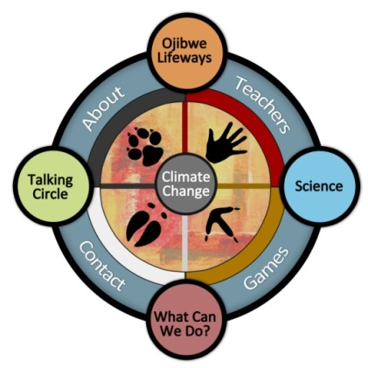
Gikinoo’wizhiwe Onji Waaban (Guiding for Tomorrow)
or “G-WOW”
Changing Climate, Changing Culture Initiative
Integrating Place-Based and Scientific Evidence for Climate Change Literacy & Action
Shared by Cathy Techtmann- Environmental Outreach State Specialist
UW Environmental Resources Center
Professor, University of Wisconsin-Extension
NOAA Climate Steward

Slide 2





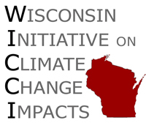
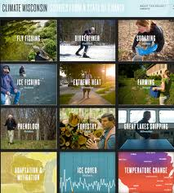







G-WOW Project Partners
Additional support
Funding

Slide 3
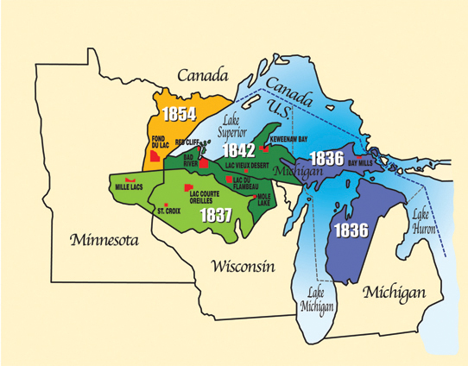
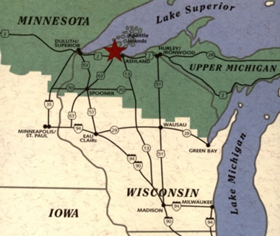
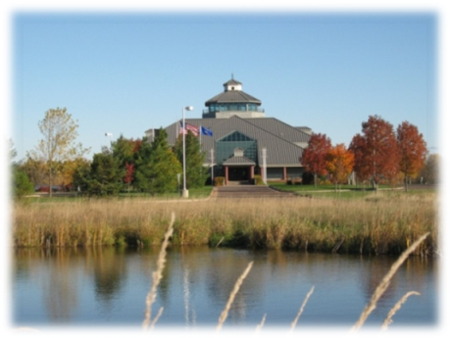
PROJECT LOCATION
Located in the heart of the Lake Superior Region. This area includes 11 Ojibwe Tribal Nations living within the “Ceded Territory” of MN, WI and MI.
Based at the Northern Great Lakes Visitor Center Ashland, WI

Slide 4
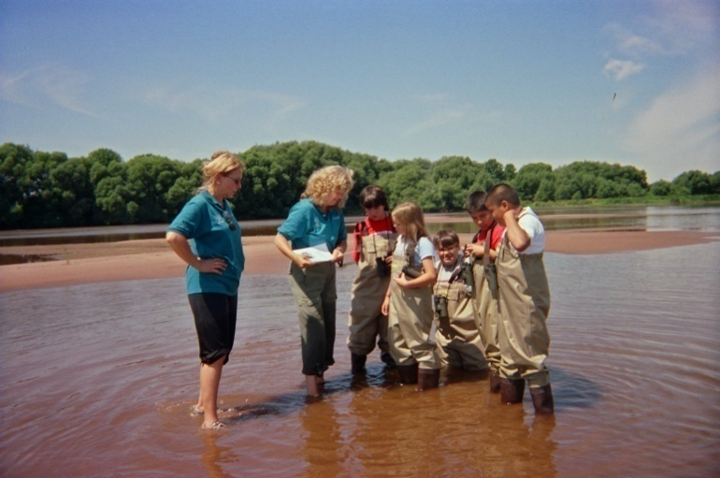
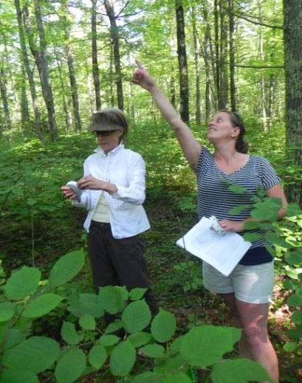
TARGET AUDIENCES
Learners (middle school students to adult audiences)
Teachers, Informal Educators, Community Leaders
General Public

Slide 5
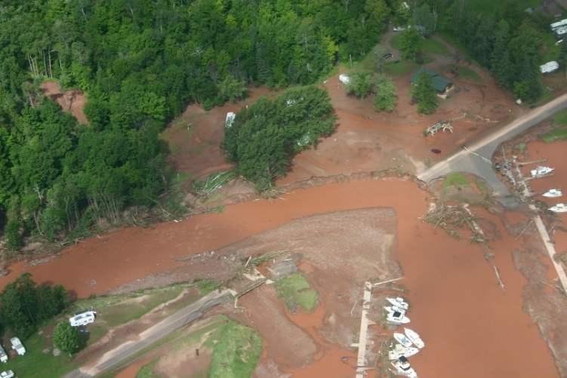
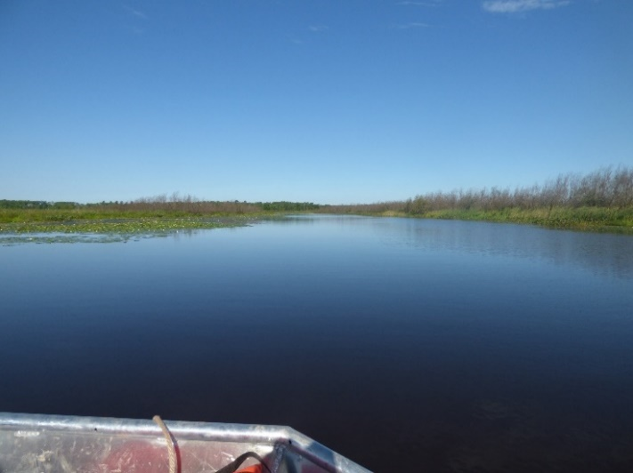
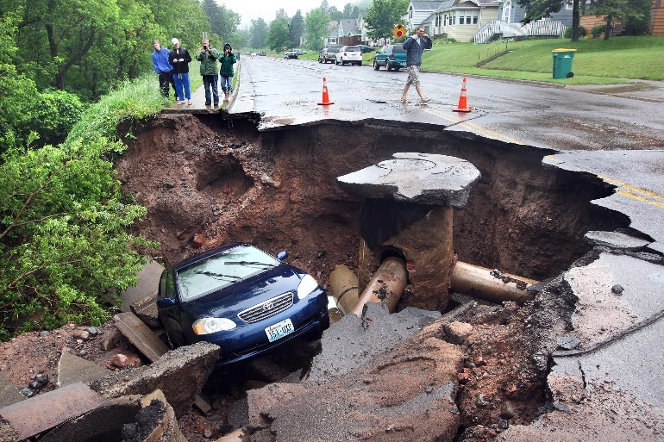
G-WOW Roots
Increasing evidence that climate change is affecting the sustainability of Lake Superior coastal resources, communities, and culture, including public safety
Concern about how climate change impacts Ojibwe treaty rights and traditional cultural practices within the Ceded Territory.
2016 NW Wisconsin Flood
Loss of wild rice, Kakagon Sloughs-Bad River Tribe
Duluth flooding 2014, 2015

Slide 6
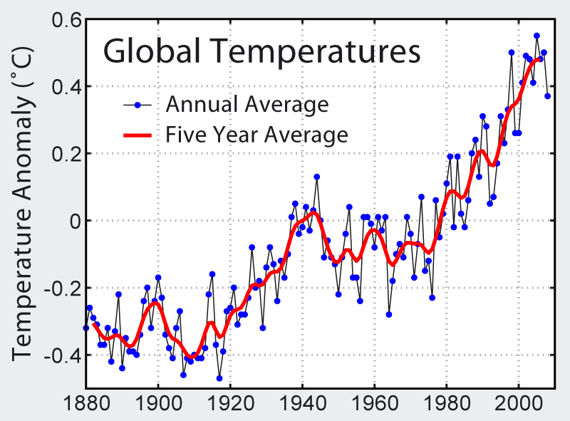
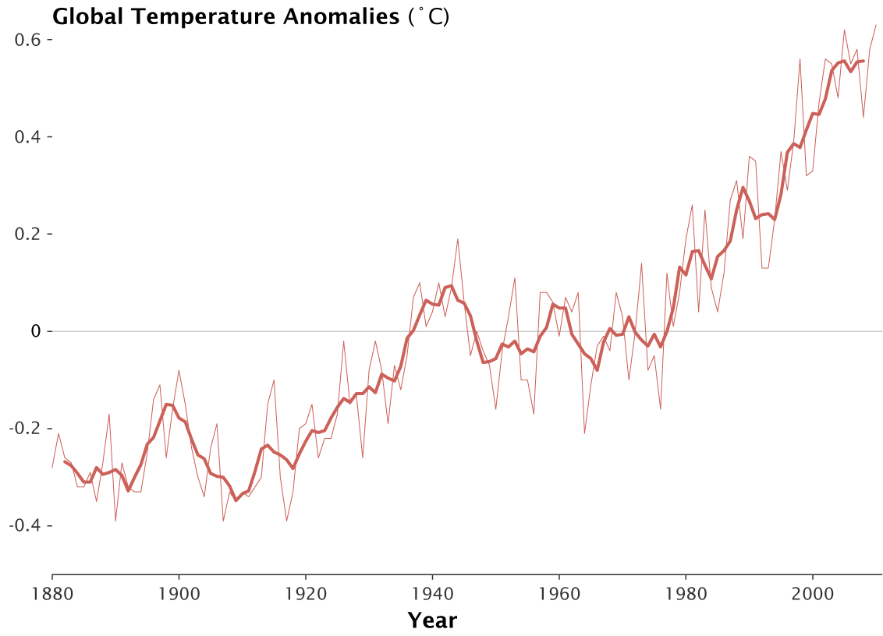
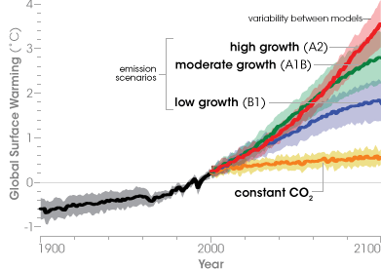
“Traditional” climate literacy models based on “tech transfer” of scientific information were not resonating with audiences.

Slide 7
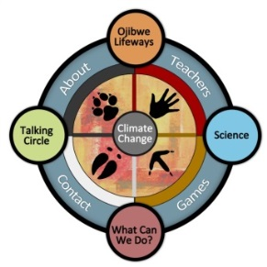
Our Goal through G-WOW
Increase learner’s awareness of climate change
by engaging them in investigating how climate change
affects what they value in
their culture, economy, and community
Provoke action to address climate change through
mitigation and/or adaptation

Slide 8
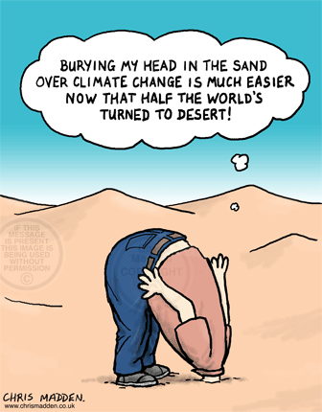
Research Basis for the G-WOW Model
“…local, place-based evidence of climate change gained through experiential learning is as, or more effective than, simply studying analytical climate change data to increasing climate change literacy.”
“The Psychology of Climate Change Communication”, Columbia University 2009

Slide 9
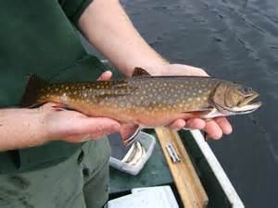
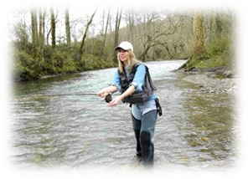
How does the G-WOW Model increase
climate awareness?
By revealing how climate change is affecting the
sustainability of species and habitats
that support cultural practices people value
based on
place-based evidence they can observe
integrated with climate science
to provoke action
Notes:
The sustainability of species, and the habitat conditions it requires, is the key that links place-based evidence people can observe with science-based projections of how environmental variables (temperature, precept, storms, drought) are changing.

Slide 10
Benefits of the G-WOW Approach
Creates a culturally relevant climate change perspective
Links place-based evidence with scientific climate change research through the sustainability of species and the habitats that support cultural practices
Makes the model transferrable across different cultures

Slide 11
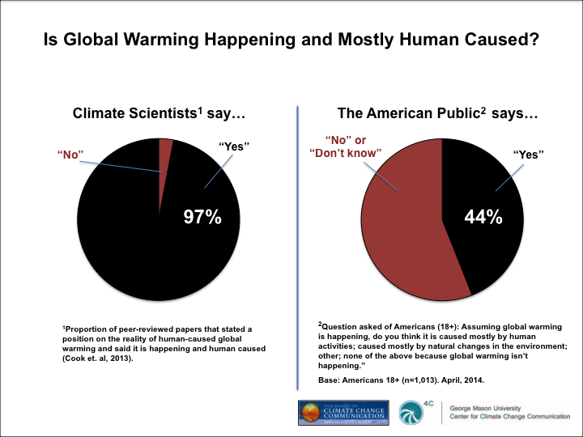
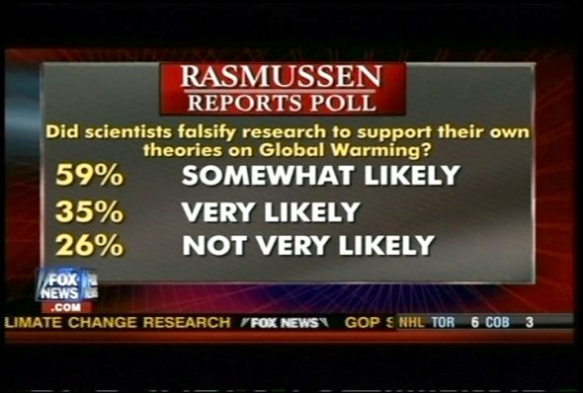
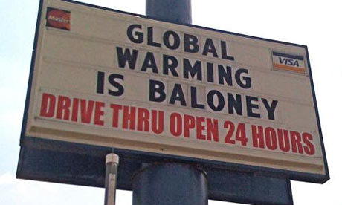
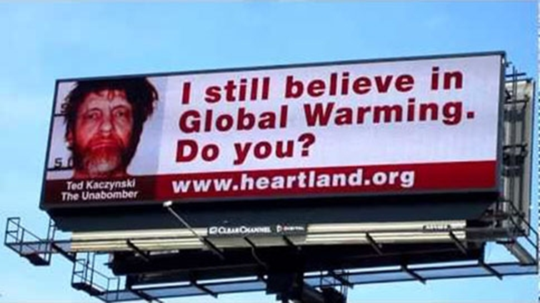
G-WOW Key Principles
CLIMATE CHANGE IS REAL
NASA

Slide 12
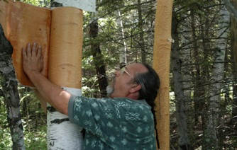
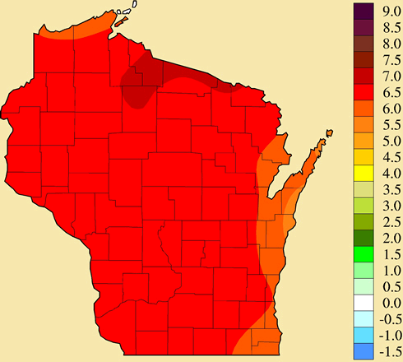
CLIMATE AFFECTS CULTURE
Ojibwe cultural practice of harvesting birch bark.
Paper birch is a boreal species that relies on a cool climate.
Projected change in Wisconsin’s annual average temperatures
in ºF, 1980-2055
Notes:
The Ojibwe cultural practice of birch harvesting relies on the sustainability of paper birch. This species requires a cool climate. What is the future for Paper Birch and the cultural practice of birch harvesting in a warming Wisconsin?

Slide 13
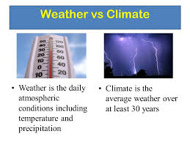
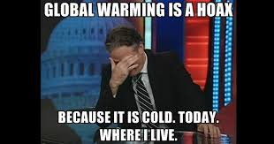
WEATHER AND CLIMATE ARE DIFFERENT

Slide 14
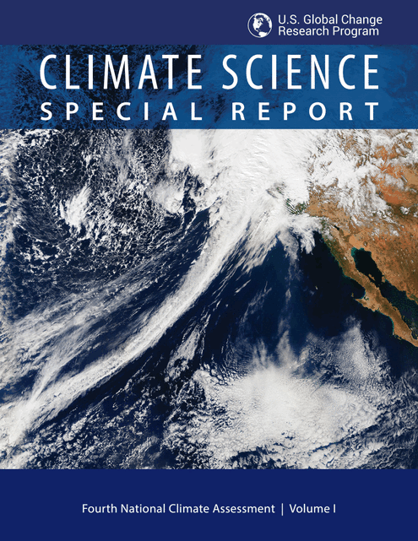
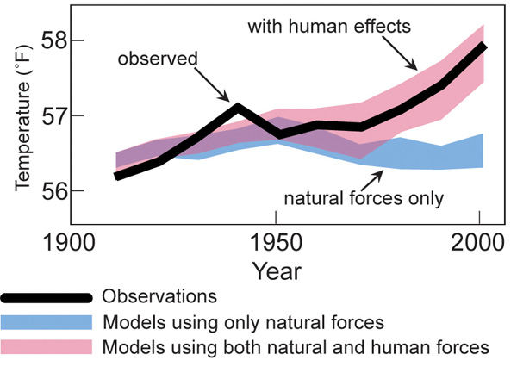
HUMANS CONTRIBUTE TO CLIMATE CHANGE
13 federal agencies unveiled an exhaustive scientific report on Friday that says humans are the dominant cause of the global temperature rise that has created the warmest period in the history of civilization.
Source: EPA
Notes:
This statement is a cause of disagreement over some who believe climate change is happening, but may not be convinced that humans are causing it. This graph explains this correlation. If we accept humans cause climate change, then we are not powerless victims– we can do something about it! In 2017, thirteen US agencies issued a Special Climate Science Report supported human’s role in climate change.

Slide 15
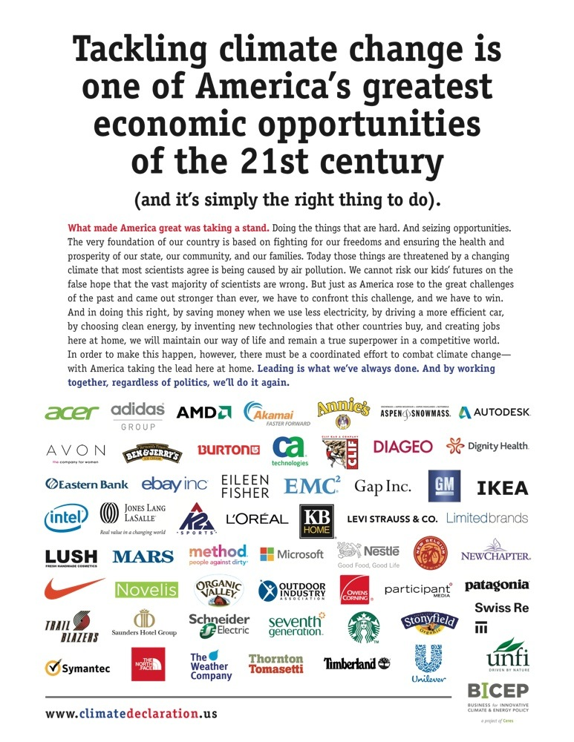
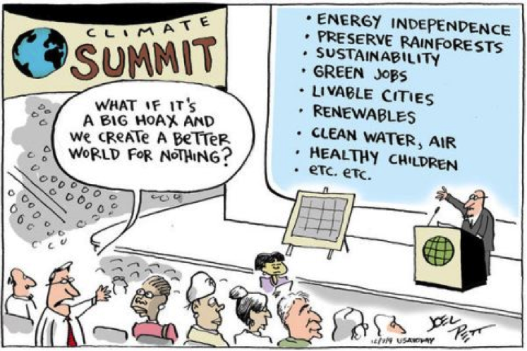
Therefore, WE CAN MAKE A DIFFERENCE
Notes:
Climate change is not anti-economic development as evidenced by the many corporations (some Fortune-500 companies) that are promoting it as an economic development opportunity.

Slide 16
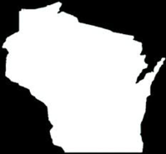
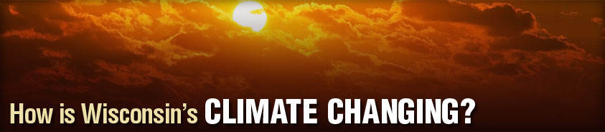
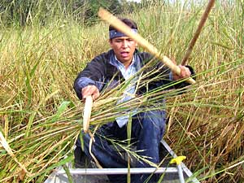
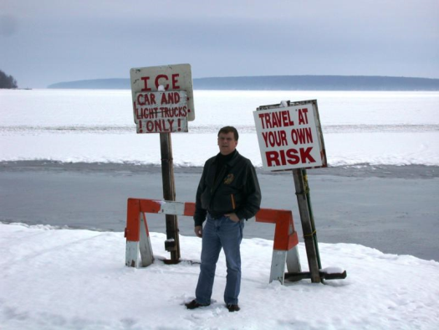
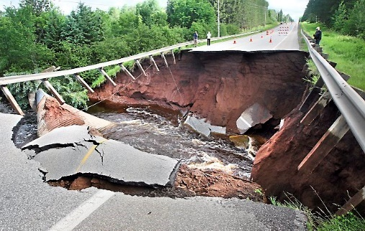
Place-based Evidence = Evidence we can observe
Unprecedented cancellation/disruption of tribal wild rice harvests for the Lake Superior Ojibwe
Ice cover on Lake Superior at Bayfield, Wisconsin has decreased approximately 3 days/decade or 45 days over the past 150 years.
Lake Superior: near record low (2012-2013), extreme flooding 2014, 2015, 2016. Now at almost record high levels and temperature.

Slide 17
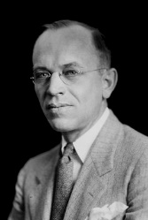
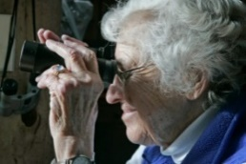






Phenological Evidence in Wisconsin
during the past 60 Years…
Bird migration | Vegetation
Geese Arrival 29 days earlier | Baptista (Wild Indigo) first bloom 18 days earlier
Cardinal first song 22 days earlier | Butterfly weed first bloom 18 days earlier
Robin arrival 9 days earlier | Marsh milkweed first bloom 13 days earlier
From 1950-2014 , on average spring has occurred 12 days sooner than expected-- fall has started 12 days later
  Growing season lengthened by 5-20 days across the state,
  with greatest change in NW Wisconsin

Slide 18
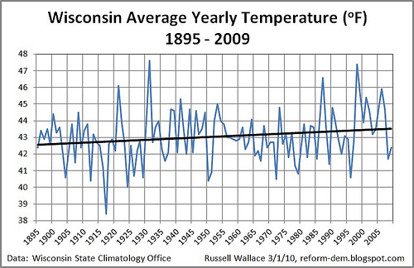
Scientific evidence = Evidence from measurements & models
1. HISTORIC EVIDENCE based on recorded facts
From 1950-2006
  +1ºF over all temperature increase
  +2 - 2.5ºF increase in NW Wisconsin.

Slide 19
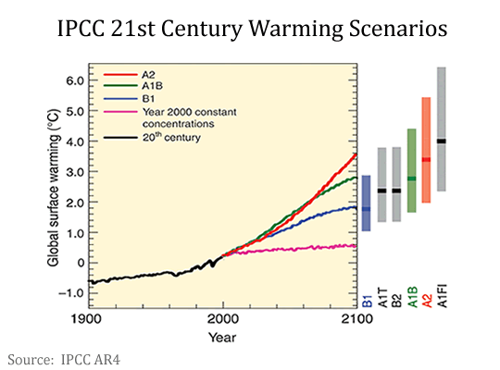
2. CLIMATE PROJECTIONS
based on computer modelling
The G-WOW model and curriculum uses the A1B climate scenario, a “middle of the road” scenario where carbon emissions remain similar to today’s.
Notes:
Some scientists suggest that we have already exceeded the level of carbon emissions used in the A1B “middle of the road” scenario and that temperature increases are now more reflective of the A1 “higher emission” scenario. The B1 scenario reflects a “lower emission” scenario where carbon emissions in the future are lower than today.

Slide 20

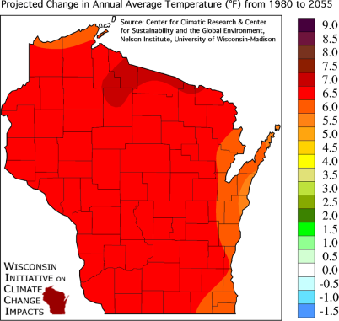
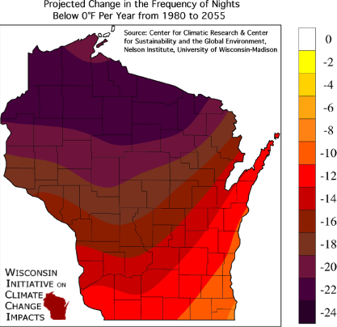
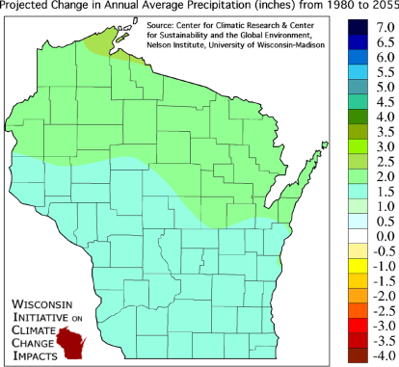
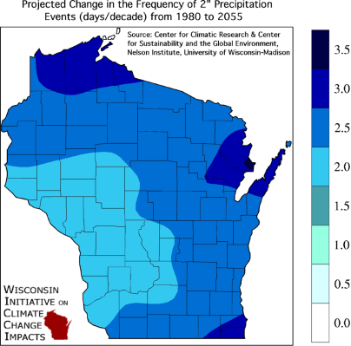
WISCONSIN
CLIMATE PROJECTIONS (1980-2055)
Based on A1B “middle of the road” scenario
OVERALL WARMING
Change in Average Annual Temps +4-9ºF
WARMER WINTERS
Decrease in Frequency of Cold Nights-
esp. Northern Wisconsin
MORE EXTREME WEATHER
Up to 4.5 inch annual mean increase in precip
25% increase in the frequency of 2-inch or greater rainfall events
Notes:
The G-WOW website’s “Investigate the Science” section includes links to climate maps for other states and US regions.

Slide 21
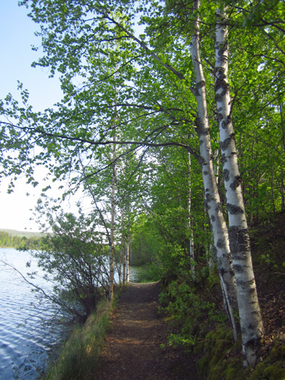
CLIMATE WINNERS & LOSERS
Climate change will affect the habitat conditions that species depend on
to thrive and survive
We depend on the sustainability of these species for
supporting our cultures and economies

Slide 22
G-WOW model: integrating culture with science
Cultural Practice
Key Species
Place-based & Scientific Evidence
What cultural, recreational, or business practice is important to you?
What species is needed to
support this practice?
What changes are you seeing in the key species or in the habitat it requires?
What changes does science project will occur in environmental variables critical to supporting these habitat conditions?
What habitat conditions are required for species sustainability
or
are required for this practice
The G-WOW model links culture & science through the
sustainability of species and habitat conditions
Notes:
“Cultural” practices can be defined as any activity we engage in for recreational, business, or social events. The G-WOW model uses examples of how climate change is affecting the cultural practices or “lifeways” of the Lake Superior Ojibwe people to provide an example of how climate change is affecting all of us.

Slide 23
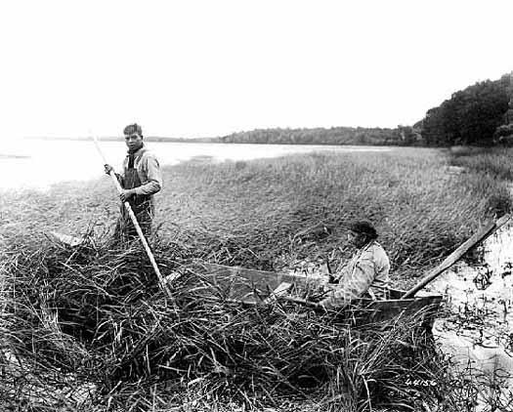
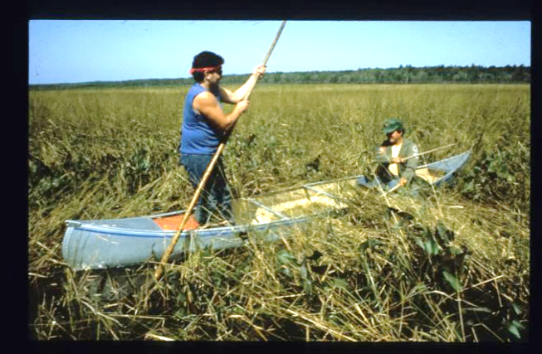
The G-WOW model uses place-based climate impacts on Ojibwe cultural practices as a baseline indicator of a changing climate for all cultures.
WHY?
The Lake Superior Ojibwe have relied on the sustainability of
plant and animal species for generations to support subsistence, cultural, and spiritual practices or “lifeways”
Traditional or “tribal” ecological knowledge (TEK)
of natural systems provides long term place-based indicators
of change that can reduce the influence of weather variability when evaluating place-based evidence

Slide 24
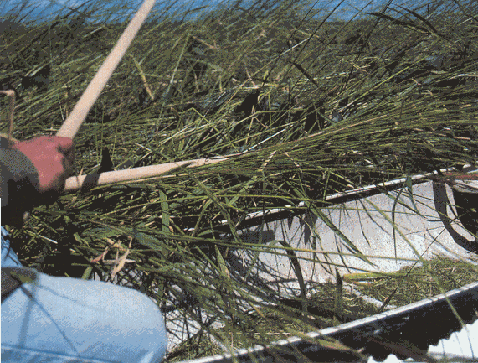
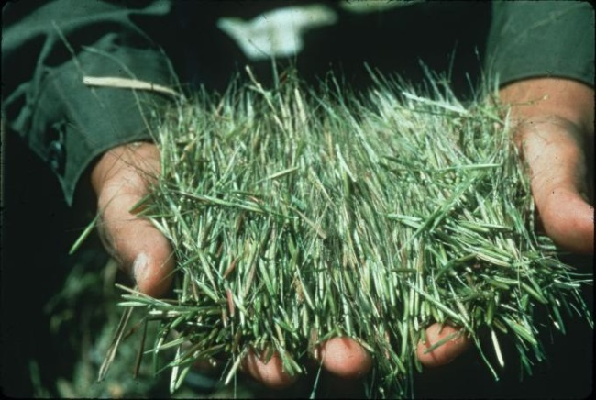
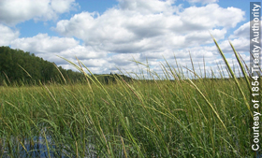
Applying the G-WOW model: Wild Ricing
(using a vertical format to demonstrate the model)
Wild rice harvesting is important to the Lake Superior Ojibwe Indians for subsistence, spiritual, and ceremonial purposes
Wild rice harvesting depends on the sustainability of manoomin (wild rice)
The sustainability of manoomin depends on habitats with
shallow water
moderate water level fluctuations
cool growing season temperatures
Notes:
We’ll walk through how the G-WOW model works using this step-by-step vertical format, then place all the elements into the horizontal G-WOW model template.

Slide 25
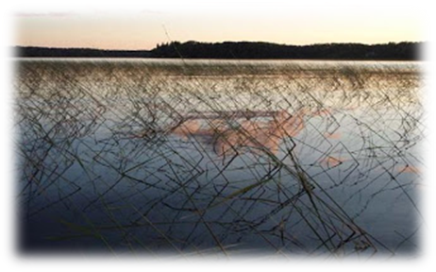


Do culture and science agree that climate change is affecting
the sustainability of wild rice ?
PLACE-BASED EVIDENCE
Historic cancellations/disruptions in wild rice harvests (2007-2012, 2016 flood damage) based on TEK
SCIENCE-BASED EVIDENCE:
Projected change in climate variables affecting habitat conditions for wild rice survival
HEAT
DROUGHT
GUSHERS
Annual average temperatures in ºF,
Frequency of 90-degree days
Change in frequency of 2” + precip
Projected changes in climate variables 1980-2055 (A1B scenario)

Slide 26




G-WOW Model: Wild Rice (Manoomin) Harvesting
Cultural Practice
Key Species
Place-based & Scientific Evidence
Unprecedented harvest cancellations since 2007; 2016 floods
Requires shallow water, moderate water level changes, cool growing season
TEK: Evidence of change embedded in the Ojibwe Language;
Manoominike-giizis (August) = “Ricing Moon”
Wild rice is now harvested in September
Projected frequency of 2”+ rain events,
1980-2055
What do these changes mean for sustainability of wild rice?
What does this mean for cultural practices that rely on wild rice?
Notes:
In this model, I am using scientific projections for the environmental variable of increasing intense rainfall events to demonstrate how culture & place-based evidence of climate change is syncing up with what scientific projections of change.

Slide 27






Maple Sugaring
Cultural Practice
Key Species
Place-based & Scientific Evidence
Requires cool moist forest habitats, cold winter nights for sugar production
What does this mean for sustainability of sugar maple and the
cultural practices and businesses that rely on it?

Slide 28




Fishing
Cultural Practice
Key Species
Place-based and Scientific Evidence
Requires cold water habitats with high oxygen levels
Projected change in Wisconsin’s annual average temperatures in ºF, 1980-2055
Climate models predict up to 95% of brook trout habitat across Wisconsin could be lost if the average annual summer air temperature increased just over 5 º F.

Slide 29




Outdoor Recreation
Cultural Practice
Key Species
Place-based and Scientific Evidence
Requires water for breeding, warmer temperatures encourage more rapid generational development
Projected change in annual temperatures in ºF, 1981-2070
The future for mosquitos is unclear. Warmer temperatures support new species such as the West Nile and Zika viruses
(Source: NOAA NCEI / CICS-NC)

Slide 30






Winter Recreation
Example of applying the G-WOW model to a non-species dependent
cultural practice
Cultural Practice
Key “condition”
Place-based and Scientific Evidence
Requires cold temps
Projected change in Wisconsin’s winter average temperatures in ºF, 1980-2055
What do these changes mean for winter outdoor recreation and businesses that depend on cold and snow?

Slide 31







Other Examples of applying the G-WOW model
Cultural Practice
Eating Friday Night Perch fish fries
Requires cool water. Warmer water also favors invasives that compete with Yellow Perch
Credit: GLERL. 10/2014
Notes:
This fun G-WOW model was created by a teacher whose students loved Friday night perch fish fries. In this case, the place-based evidence was not fewer fish caught, but the higher cost of locally sourced perch used for those fish fries.

Slide 32




Southern Florida Naturalist Example
Cultural Practice
Large circles = 50 or more pythons captured
Hiking in the Everglades
Invasive Burmese python:
requires very warm, moist “tropical” habitats
Increase in 95+-degree day/year, 2041-2070.
What does a changing climate mean for the sustainability of this invasive species? How could this affect recreation, nature-based tourism economies?
Notes:
This unusual G-WOW example was provided by a naturalist who was not able to take her students hiking in the Everglades due the presence of invasive Burmese pythons. These invasive snakes will be favored by a changing climate. Invasive species are often favored by climate change because of their adaptability to warmer temperatures and/or because they move into niches vacated by native species that cannot thrive when environmental variables change due to climate change.

Slide 33




Appling the G-WOW Model to an economic activity
Key Species/Habitat
Place-based & Scientific Evidence
Cultural Practice
Fewer cold nights = less frozen ground affecting harvest & transport of logs to market
Projected change in frequency of nights below 0 ºF, 1980-2055
"38 days of frozen ground lost since 1949. That's only 60 years and we've lost ... five weeks, almost six weeks. What does that mean for forest operations?“
Eau Claire, WI Logger From: “Shorter winters chip away at northern logging season”, The Daily Climate, 2013
Notes:
The G-WOW model can be used for economic practices and resonates with audiences with audiences who may have those concerns. This is another example of a non-species, habitat dependent cultural practice. Winter logging relies on frozen ground and roads. There is place-based evidence of winter logging being limited due to road conditions not supporting equipment. In Wisconsin, the frequency of cold nights needed to freeze logging roads is expected to significantly decrease as winters warm.

Slide 34




Another G-WOW Model: Corn Farming
Place-based & Scientific Evidence
Key Species/Habitat
Cultural Practice
Change in frost-free days 1958-2012.
Warm temps, ideal 65-80 degrees F
Ample moisture
Projected Change in Summer Average Temperature (°F) from 1980 to 2055
“Northern Wisconsin agriculture, for example, is likely to benefit from climate change further into the future, due to its more northern location.”- NOAA/ U of Iowa
Notes:
Not all cultural practices are “losers” if changes in environmental variables (like temperature) favors the sustainability of a species a cultural practice the practice depends on. However, there may be other limiting factors, such as precipitation, that could offset .

Slide 35
Create Your G-WOW model
Cultural Practice
What cultural practice do you enjoy?
What species is needed to
support this practice?
What changes are you seeing in the key species or in the habitats it needs?
What changes in environmental variables critical to supporting these habitat conditions are projected by climate science? Variables may include: temperature, precipitation, drought, intense rain/ storms, humidity, etc.
What habitat conditions does the species need to survive and thrive or are required forr the cultural practice?
Do culture and science agree? Is climate change is affecting this cultural or economic practice?
What implications does this have for you, your community or economy?
What can you do to fight climate change--with change?
Notes:
Now it’s your turn to create a G-WOW model for a cultural practice you enjoy. Plug in cultural practices that are valued by the audiences you serve. The big “so what” is taking action to reduce the impacts with change that mitigates or adapts to a changing climate. Be creative and have fun with this model!

Slide 36







The G-WOW website has place-based activities that apply the G-WOW model to increase climate awareness
Climate Forest Winners and Losers Game
HOW MIGHT CLIMATE CHANGE OUR FORESTS?
Winners
Losers
Based on research from the Northern Institute of Applied Climate Science,
USDA-Forest Service
Notes:
See the G-WOW website under “RESOURCES” for instructions and materials for playing this game.

Slide 37

The G-WOW model builds awareness…
(the set up)
Do culture and science agree… is climate change affecting the sustainability of the key species that supports an a cultural practice you value?
What is the future for this cultural practice based on place-based evidence and scientific climate change projections?
What do these changes mean for the environment, community, economy?

Slide 38

… our real goal is to provoke learners to ACT
(the spike)
What can we do to mitigate or adapt to climate change impacts?
How can we “provoke” action on climate change?

Slide 39


The BIG “SO WHAT”… WHAT CAN WE DO?
The G-WOW model provides ideas and templates for creating a climate service project and a blog where projects and results can be shared
Mitigation Adaptation
Putting on the brakes to avoid an impact
Lessening the impact
Notes:
Mitigation is like putting on the brakes to avoid hitting the wall. Adaptation is like the air bag that deploys after we’ve hit the wall to lessen the impact. Both strategies can help reduce negative impacts!

Slide 40


Mitigation
Reducing, stabilizing, or eliminating C02 emissions from
primarily human caused sources
What can we do to reduce greenhouse gases?
Reduce Our Carbon Footprint
Enhancing “sinks” that accumulate/store C02

Slide 41



Adaptation
Recognize that climate change is occurring and make adjustments to reduce vulnerability & harmful impacts
What could we do to adapt to climate change?
Increase resiliency, habitat conservation and restoration, establish “refuge” areas for vulnerable species, manage for species that will be tolerant of climate change

Slide 42

We need to do both adaptation AND mitigation!

Slide 43
Does G-WOW model for climate education work?
Based on survey of educators who attended the 2015 G-WOW Institute
and trained in using the G-WOW model
Agree to strongly agree in increase in personal climate literacy and skills for teaching about climate change
Agree to strongly agree in being more confident in teaching about climate change using the model
Agreement See the model as transferable to their student populations despite location
All respondents use the G-WOW model in some form
Source: Patty Carpenter, 2016 UMD Master Degree Thesis:
“G-WOW Changing Climate, Changing Culture Professional Development's Influence on Classroom Teachers”

Slide 44

G-WOW Outreach Tools
Experiential learning
Ojibwe language, TEK, and cultural elements infused
Multi-cultural perspectives
All apply interpretive principles
Web Curriculum
www.g-wow.org
Climate Change Discovery Center: Public outreach and and Climate “Camps”
Professional Development Training

Slide 45



G-WOW Changing Climate, Changing Culture Discovery Center
Northern Great Lakes Visitor Center, Ashland WI
Major teaching exhibit and interactive kiosk
located at the Northern Great Lakes Visitor Center, Ashland, WI
Guided programs & “Coastal Climate Camps” are avaiable
100,000 visitors, students, community members annually

Slide 46



G-WOW Changing Climate, Changing Culture Professional Development
4-day experiential professional development based on the G-WOW model
Location: Northern Great Lakes Visitor Center-Ashland, WI and the Apostle Island National Lakeshore, and Ojibwe tribal communities
"When I saw that we would be teaching about climate change…, I thought Ugghhh!!! Now I see that the cultural impact of climate change is how to approach middle school kids with this topic.“
- Tara Fiera, Marathon Venture Academy, G-WOW Institute Alumni

Slide 47

Ojibwe Lifeways
Place-based evidence of climate impacts on the sustainability of key species supporting a seasonal Ojibwe cultural practice.
NEW in 2018
“Hear the Water Speak” and more resources!
Talking Circle
Sharing service learning projects via an interactive blog
Investigate the Science
Climate science from federal, state, and tribal sources
What Can We Do?
Taking action through climate service learning projects
G-WOW Web-Curriculum
www.g-wow.org
On-line climate change service learning curriculum
Represents application of the 4-season G-WOW model

Slide 48


Additional On-line G-WOW Resources
Educator Resources
  G-WOW Curriculum Guide
  Lesson Plans, Resources, News,
  Training Vignettes, Activties
About
Project background
Partner acknowledgements
Climate Change
Climate 101 literacy basics
Contact
For more information
Games
Interactive climate games
Take a Test Drive
Notes:
Click on the car to take a test drive of the G-WOW website.

Slide 49


Each Ojibwe Lifeway unit includes:
Intro to the cultural practice and the species supporting it
Coming in 2018: A new curriculum unit on water & climate,
plus web-site wide upgrades
Learning objectives
Baseline ecological information explaining habitat conditions needed for sustainability of the key species(s), possible climate stressors & impacts
Cultural connection: Cultural importance of the key species to maintaining an Ojibwe lifeway
Menu of place-based resources to evaluate impacts on the key species.
Students investigate place-based climate observations within their culture/community
Activity Guides focus investigations

Slide 50


Investigate the Science
Customized for each Ojibwe Lifeway unit.
A toolbox to investigate and evaluate scientific climate change research via interactive maps for Wisconsin, the Ojibwe Ceded Territory of Minnesota, Wisconsin, and Michigan, and links for US state climate mapping resources
Research climate trends and projections & evaluate impacts on the sustainability of key species.
“Test It” : students test their own climate change hypothesis through self-designed investigations.
Activity Guides focus student investigations.

Slide 51


What Can We Do?
Act on knowledge gained by developing a service learning project to address climate change impacts.
Provides service learning project templates and ideas.
Tools for customizing service learning projects to meet learner’s interests and learning style.
Provides ready-made project templates such as Project Budburst, climate phenology wheels, climate collages provide fun, service learning options.

Slide 52


Talking Circle
Post & share results of service learning projects
See projects from other participants.
Projects are searchable by location and type
Variety of project uploads possible: pdfs, images, YouTube & web links
After posting use simple tool to evaluate project impacts

Slide 53

We invite you to use the G-WOW model to increase climate change literacy based on the
unique lifeways of your culture.
www.g-wow.org

Slide 54

Miigwech ! (Thank you)
For more information, please contact
Cathy Techtmann-Environmental Outreach State Specialist
University of Wisconsin-Extension
715.561.2695
catherine.techtmann@ces.uwex.edu
http://fyi.uwex.edu/nglvc/

